Slide 1
Biotech Essential Statistics Series
The Art of Balancing:
Clinical Relevance vs Statistical Significance

Slide 2
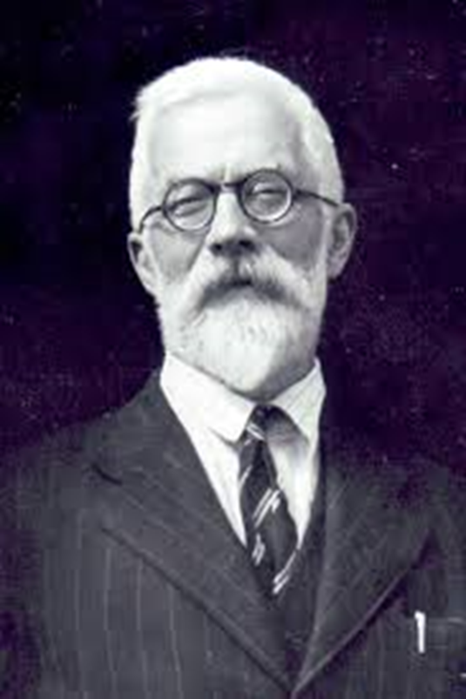
History of P-Values
R.A. Fisher
"a genius who almost single-handedly created the foundations for modern statistical science"
"the single most important figure in 20th century statistics"

Slide 3

History of P-Values
Popularised the p-value and proposed p = 0.05 as a limit for statistical significance
"The value for which P = 0.05, or 1 in 20, is 1.96 or nearly 2; it is convenient to take this point as a limit in judging whether a deviation is to be considered significant or not.“
Two-tailed test applied to the normal distribution yields the rule of two standard deviations

Slide 4
What are P-Values?
Idea behind p-values is simple
  We find an association between poverty levels and malnutrition among children under the age of five
  Is this a true association or a chance finding?
P-values measure the strength of evidence against a null hypothesis
Testing allows us to answer questions such as:
  Have cancer rates changed over time or are they constant?
  Does this drug improve survival rates?
  Is intelligence heritable?

Slide 5
Fisher Significance Tests
A general approach
Start with a “research/alternative hypothesis”
Form a “null hypothesis” – chance variation
Compute a test statistic
Compute a p-value:
“probability of having observed such an extreme value of the test statistic, if the null hypothesis is true”
If the p-value is low → evidence against the null hypothesis

Slide 6
Neyman and Pearson Hypothesis Tests
Not exactly the same as significance tests...
Suppose we’re needing to make a decision; e.g. do we approve the new drug?
Hypothesis tests provide a mechanism for making quantitative decisions about a process
Introduced the idea of false positive and false negative
Significance level, α, is then the Type I error rate

Slide 7
The Magic Number
Fisher developed the practice of quantifying the strength of evidence against the null hypothesis, but some eminent statisticians were not accustomed to the subjective interpretation
The significance level α = 0.05 is widely used by researchers worldwide and has become a magic number. It is ritualistic to use 0.05 as a cut-off mark as if other cut-off points cannot be used!

Slide 8
What are P-Values?
The ASA Statement on p-values states…
“While the p-value can be a useful statistical measure, it is commonly misused and misinterpreted. This has led to some scientific journals discouraging the use of p-values, and some scientists and statisticians recommending their abandonment,”

Slide 9
Hypothesis Testing Fallacies
FALSE
The use of α = 0.05 is standard with an objective basis
α = 0.05 is just a convention that evolved from R.A. Fisher and Neyman and Pearson
α = 0.05 is an arbitrary value and there is no sharp distinction between “significant” and “not significant”
Increasingly stronger evidence against the null hypothesis as p becomes smaller

Slide 10
Hypothesis Testing Fallacies
“if P is between 0.1 and 0.9 there is certainly no reason to suspect the hypothesis tested. If it’s below 0.02 it is strongly indicated that the hypothesis fails to account for the whole of the facts. We shall not often be astray if we draw a conventional line at 0.05”
Convention even often used one star attached to the p-value to indicate p < 0.05, two stars to indicate p < 0.01, and occasionally, three stars to indicate p < 0.001
A conclusion does not immediately become “true” on one side of the divide and “false” on the other!

Slide 11
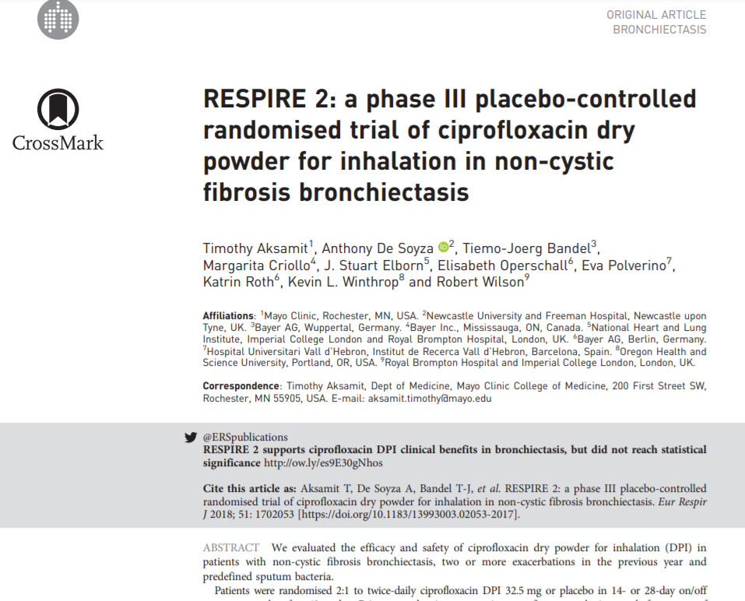
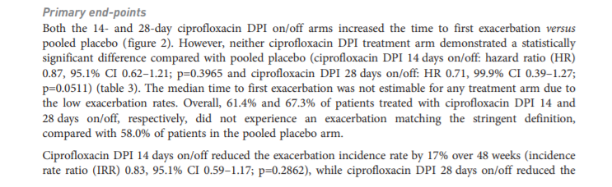
When Statistical Significance Goes Wrong

Slide 12
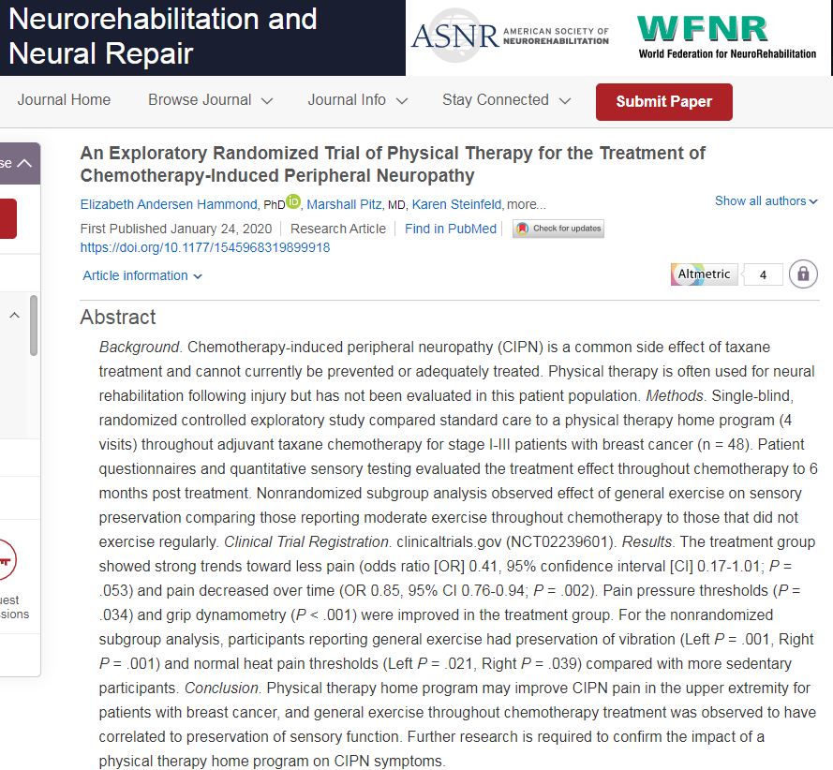
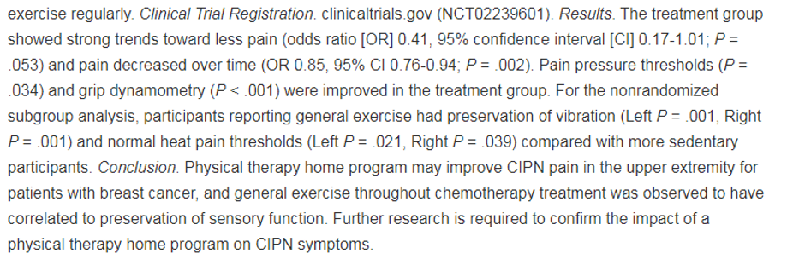
When Statistical Significance Goes Wrong

Slide 13
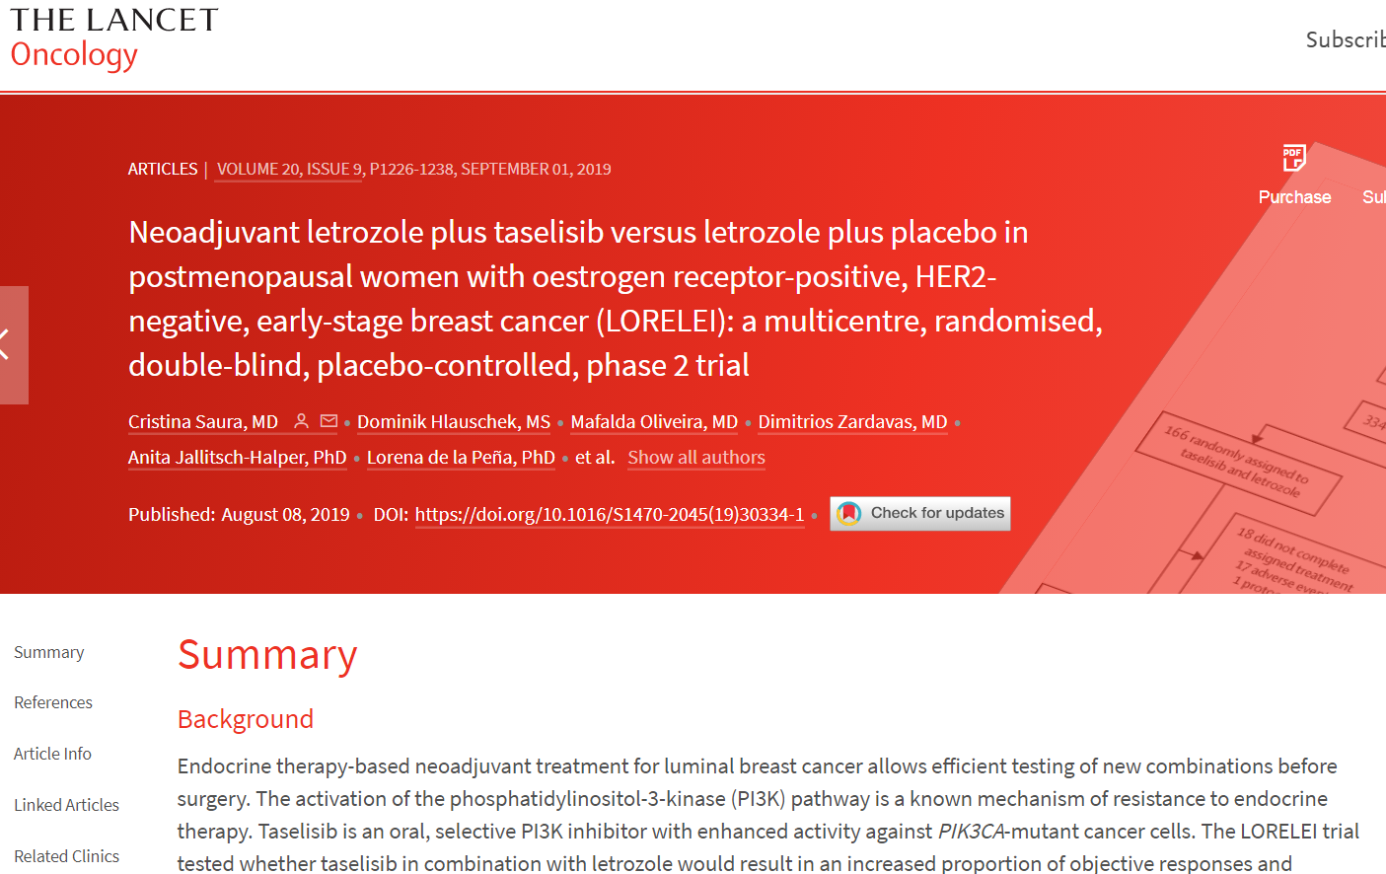
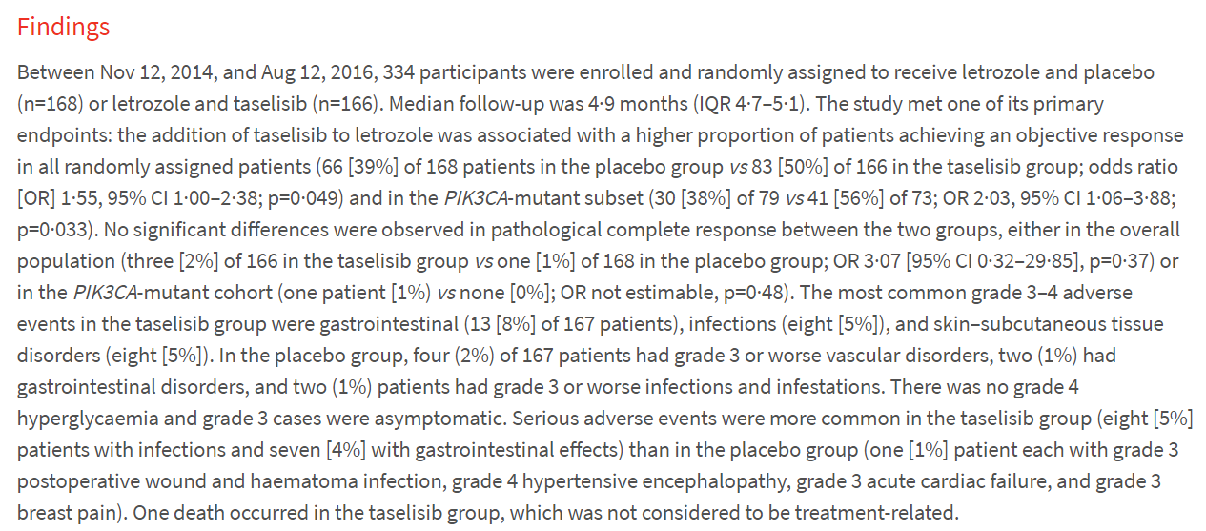
When Statistical Significance Goes Wrong

Slide 14
Data Dredging
“Any finding worth its salt should have a p-value less than 0.05”
“Statistically significant results are passports to publication”
Cherry-picking promising findings, also known by such terms as data dredging, significance chasing, significance questing, selective inference, and “p-hacking”, leads to a spurious excess of statistically significant results in the published literature

Slide 15
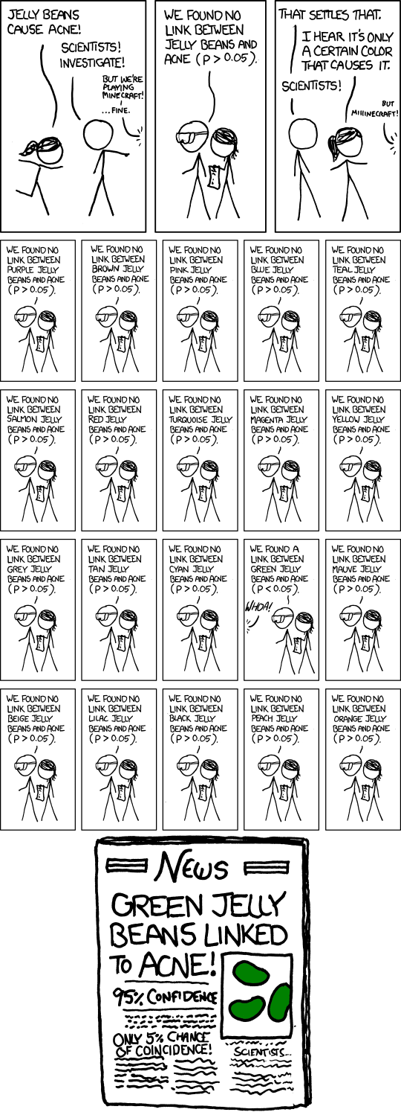
Data Dredging

Slide 16
Data Dredging

Slide 17
Data Dredging

Slide 18


Publication Bias

Slide 19
Hypothesis Testing Fallacies
FALSE
P-values measure the probability that the null hypothesis is true
Failure to reject null hypothesis leads to its acceptance
Often a desire to turn a p-value into a statement about the truth of a null hypothesis
When you fail to reject a null hypothesis it means that there is insufficient evidence to reject

Slide 20
Hypothesis Testing Fallacies
FALSE
Small p-value indicates large effects
Effect size does influence the p-value
Larger effect sizes have smaller p-values
But a p-value does not tell anything about the size of an effect!
P-values are also influenced by sample size and measurement precision

Slide 21
Hypothesis Testing Fallacies
FALSE
Statistical significance implies clinical importance
Statistical significance says very little about the clinical importance of relation
A large study can detect a small, clinically unimportant finding
Just because convention dictates non-significance, doesn’t mean that the study found nothing of clinical importance
Statistical significance is not equivalent to scientific/clinical relevance

Slide 22

When Statistical Significance and Clinical Relevance Get Mixed Up

Slide 23
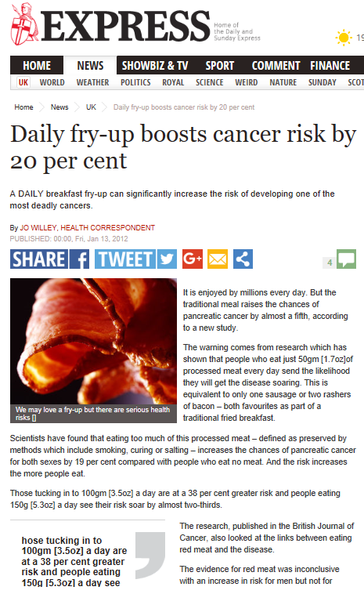
When Statistical Significance and Clinical Relevance Get Mixed Up

Slide 24
When Statistical Significance and Clinical Relevance Get Mixed Up
Pancreatic Cancer
1 in 80 lifetime risk of pancreatic cancer

Slide 25
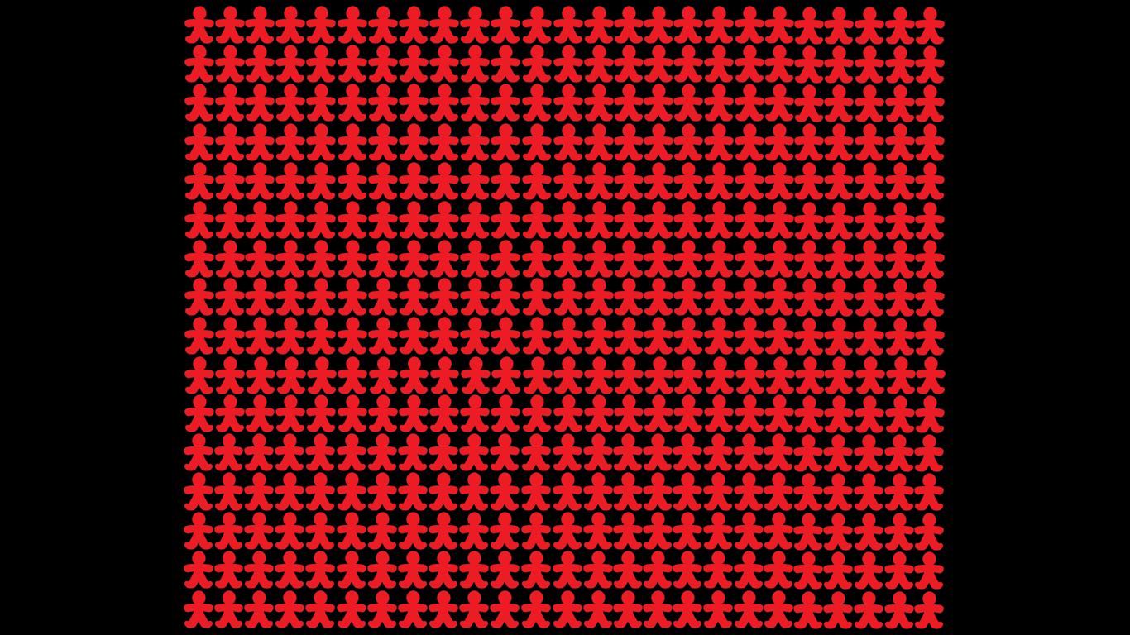


Slide 26
When Statistical Significance and Clinical Relevance Get Mixed Up

Slide 27


Slide 28
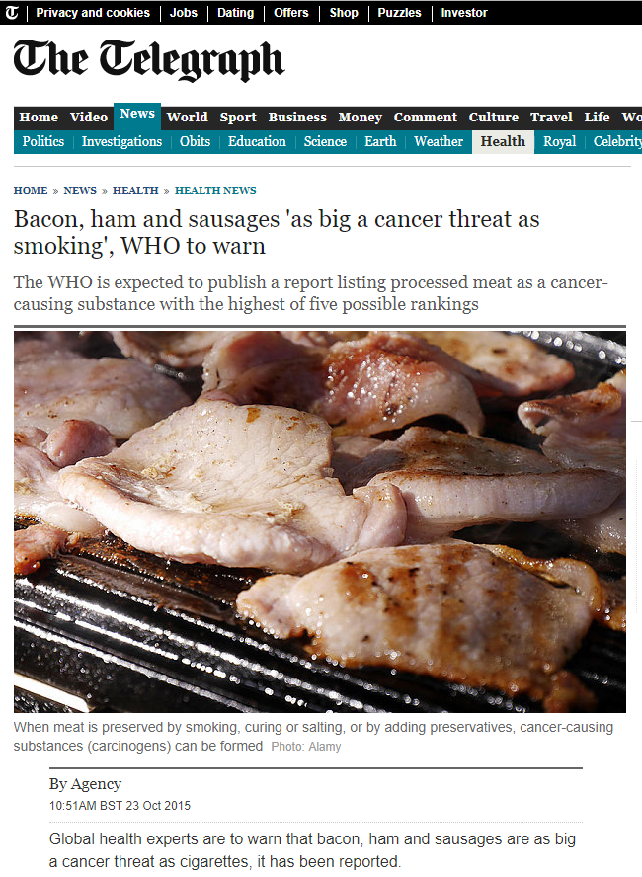
When Statistical Significance and Clinical Relevance Get Mixed Up

Slide 29
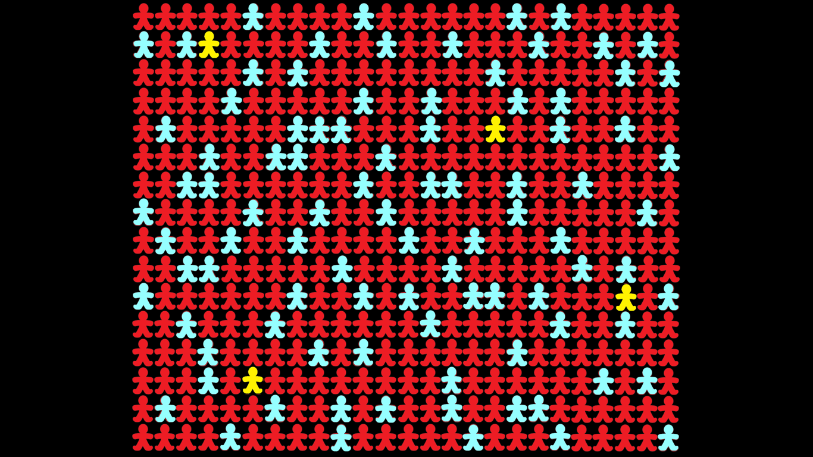

Slide 30
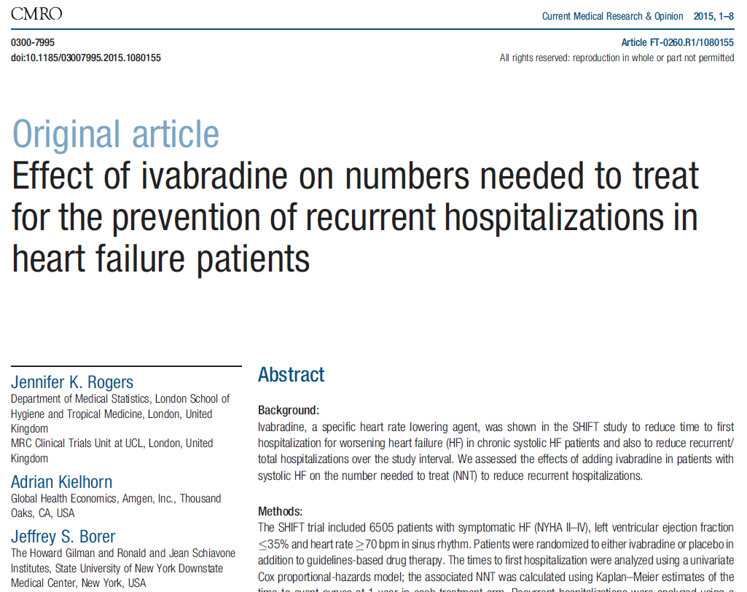
Numbers Needed to Treat
For clinical decision makes, the “number needed to treat” is an absolute effect measure that can be used to assess benefits
Inverse of absolute risk reduction

Slide 31
Numbers Needed to Treat
Primary endpoint: composite of first heart failure hospitalisation and cardiovascular death
Difference in estimate of survival (rate) at year 1:
0.851 – 0.813 = 0.038
NNT = 1/0.038 = 26
Interpretation: “The NNT to to prevent one first heart failure hospitalisation or cardiovascular death within the first year is 26”
Can similarly compute NNH (Numbers Needed to Harm) to assess safety

Slide 32
In Summary
P-values measure the strength of evidence against a null hypothesis
Hypothesis tests are a mechanism for making quantitative decisions
Significance level, α, is then the Type I error rate
α: probability of rejecting a null hypothesis that is true in the population
α = 0.05 is just an arbitrary value that has become a magic number
Failing to reject the null doesn’t mean that we accept the null as true
P-values do not tell us anything about the size of an effect
Statistical significance doesn’t automatically imply clinical relevance
Measures such as NNT and NNH can help quantify benefit and risk

Slide 33
Final Remark
In data collection we do all that we can to collect data that is as accurate as possible to avoid categorisation…
…after all this work to collect this quality continuous data, why would we then boil down our analyses and make our final decisions on the basis of a completely arbitrary pair of dichotomous categories?

