Slide 1
Biotech Essential Statistics Series
Statistical Insights for Biotech Professionals
Stephen Corson
Notes:
Note first webinar

Slide 2
Motivation
The FDA regulations on drugs for human use (21CFR314.126) notes that :
“the purpose of conducting clinical investigations of a drug is to distinguish the effect of a drug from other influences, such as spontaneous change in the course of disease, placebo effect, or biased observation”, and
“Reports of adequate and well-controlled investigations provide the primary basis for determining whether there is substantial evidence to support the claims of effectiveness for new drugs”
https://www.accessdata.fda.gov/scripts/cdrh/cfdocs/cfCFR/CFRSearch.cfm?fr=314.126

Slide 3
Motivation
ICH E9 - Statistical Principles for Clinical Trials states:
  “The statistical section of the protocol should specify the hypotheses that are to be tested and/or the treatment effects which are to be estimated in order to satisfy the primary objectives of the trial.
  The statistical methods to be used to accomplish these tasks should be described and the underlying statistical model should be made clear”
For the analysis and reporting of studies
  “It is important to bear in mind the need to provide statistical estimates of the size of treatment effects together with confidence intervals (in addition of significance tests)”

Slide 4
Topics Covered In This Webinar
This webinar will cover some statistical outcome measures that are commonly used in the analysis and reporting of clinical trials – some of which may be familiar to you
Section 1: Interpreting confidence intervals
Section 2: Decoding p-values
Section 3: Unravelling odds ratios (OR)
Section 4: Grasping hazard ratios (HR)

Slide 5
Section 1: Interpreting Confidence Intervals

Slide 6
Interpreting Confidence Intervals
When we conduct an experiment, we can use the generated data to generate a statistic (numerical summary of the data)
  Mean/average – continuous data
  Proportion – categorical data
If we were to then repeat the same experiment multiple times, and calculate the same statistic, we would not get the same answer
  There will be variability in the answers we get which means that there is uncertainty around our estimates
Notes:
The idea here is that we take a sample that is representative of the population
Conduct the experiment and estimate the sample statistic
Use the sample statistic as our estimate for the population sample statistic

Slide 7
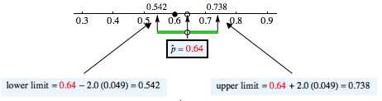
Interpreting Confidence Intervals
The reliability of our estimate for a mean/proportion (statistic) can be expressed by producing an interval estimate, confidence interval, for the estimated parameter
  Helps answer the question: “How big an error might we be making when we use the sample statistic as an estimate of the population statistic?”
The CI provides us with a range of values which is likely to contain the true value for the parameter of interest

Slide 8
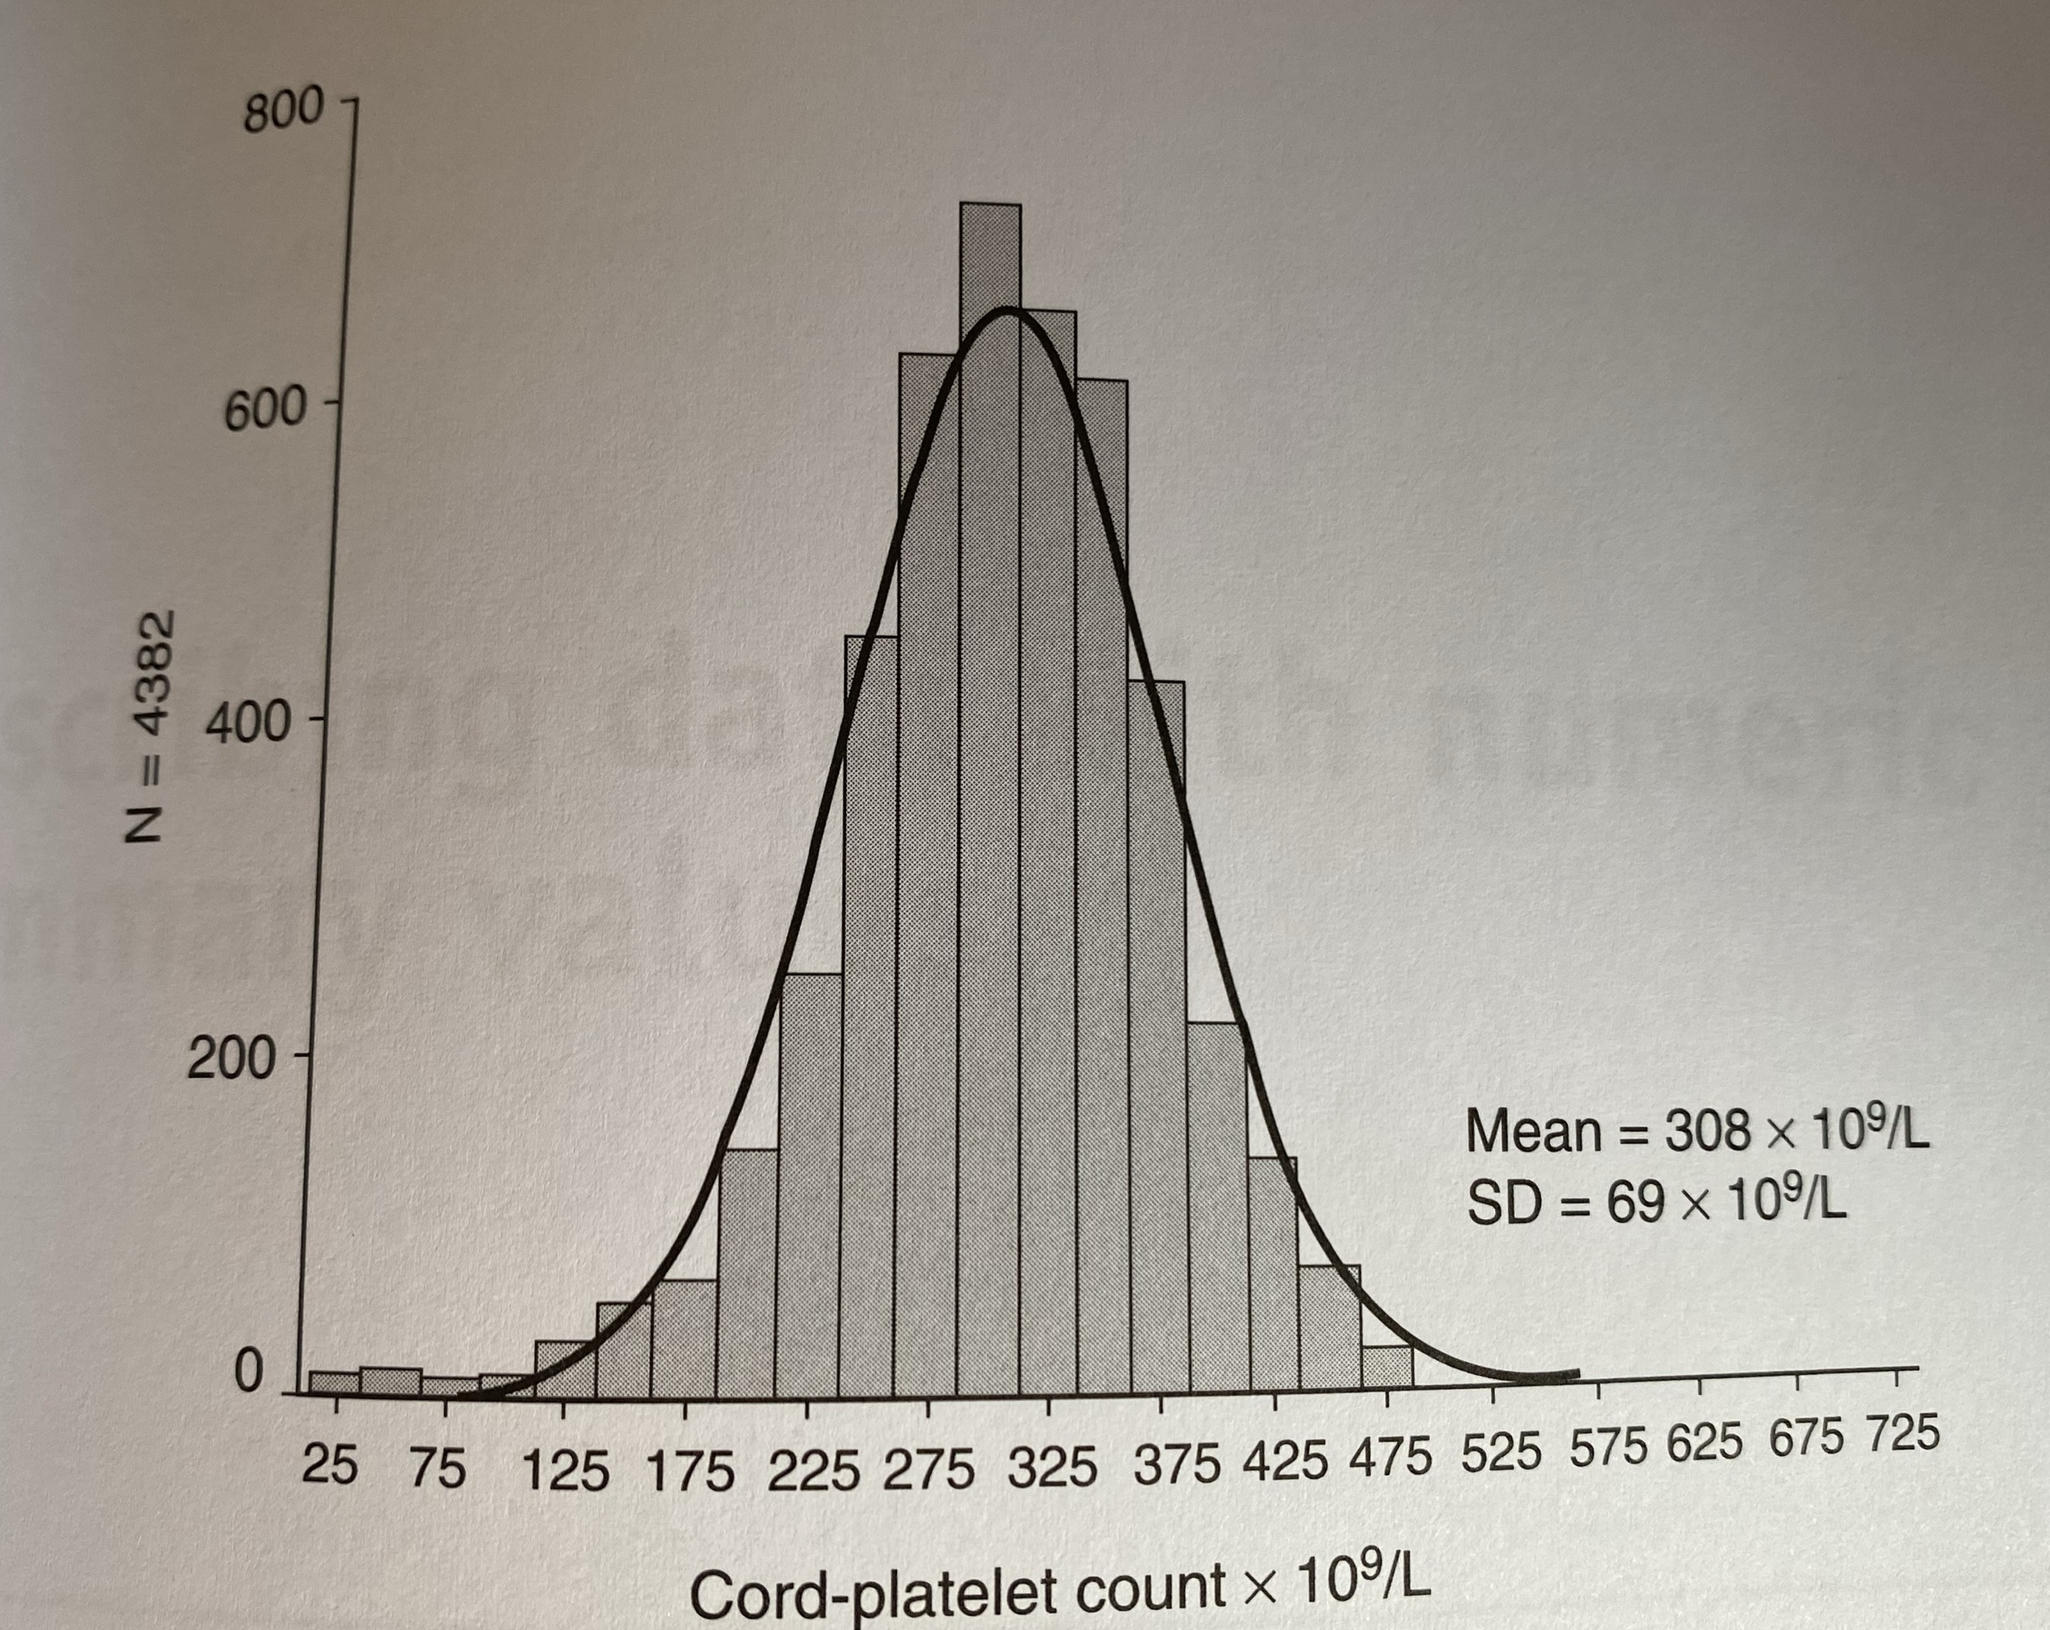
Interpreting Confidence Intervals
Interpretation: There is a 95% chance that this interval contains the true population value
Histogram shows the distribution of values for cord-platelet count (10⁹/l) in 4,382 Finnish infants from a study of the prevalence and causes of thrombocytopenia in full term infants
  Mean value is 308 x 10⁹/l
  95%CI: 303.916 to 308.084
  We can be 95% sure that the population mean cord-platelet count is between 303.916 x 10⁹/l and 308.084 x 10⁹/l
Sainio, S. et al. (2000)
https://doi.org/10.1016/S0029-7844(99)00543-8
Notes:
Thrombocytopenia exists when the count is less than 150 x 10⁹/l. Risk factor for intraventricular haemorrhage and contributes to the high neurological morbidity in infants affected.

Slide 9
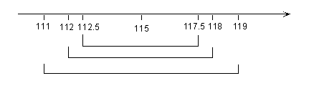
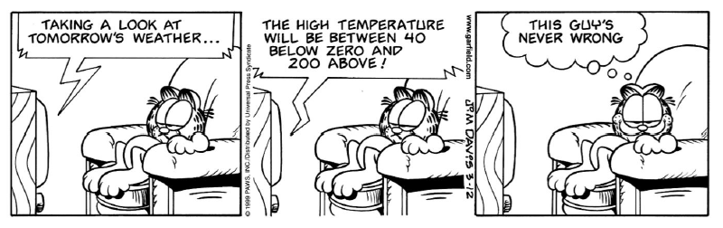
Interpreting Confidence Intervals
The width of a confidence interval depends on several factors:
Increasing sample size
Large variability in the data, or
Increasing the required level of confidence

Slide 10
Section 2: Decoding p-values

Slide 11
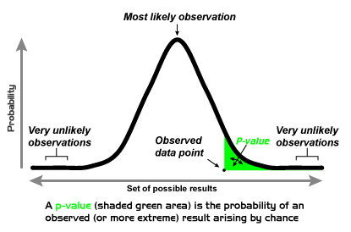
Decoding p-values
P-values are often used
to determine the efficacy
of treatments or success/
failure of a trial
  P stands for probability
  P-values range from 0 to 1
Represents the probability
of observing data such as ours, or data more extreme,
if the null hypothesis is true
P-values are often compared to a “threshold value” in order to determine success/failure
    If the p-value is below the threshold (low) → evidence against the null hypothesis
    If the p-value is above the threshold (high) → no evidence against the null hypothesis
Null Hypothesis (H₀) - Negation of the research hypothesis that generated the idea
Alternative Hypothesis (H₁) – Research hypothesis that we want to demonstrate with our data
Notes:
Values close to 0 indicate that the observed difference is unlikely to be due to chance, whereas a p value close to 1 suggests that it is highly likely that the difference observed is due to chance.

Slide 12
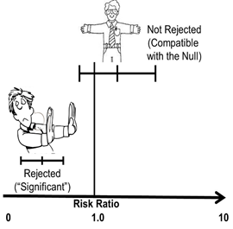
Decoding p-values
When a confidence interval contains H₀ then the p-value for the statistical test will be >0.05
Reflect the results at the level of the data and indicate the direction of the effect studied
Confidence intervals from a hypothesis test give
you a range that you can be 95% sure
would contain the true experimental results
if the null hypothesis is true
Statistic of interest | Null value
Difference | 0
Hazard Ratio | 1
Odd Ratio | 1

Slide 13
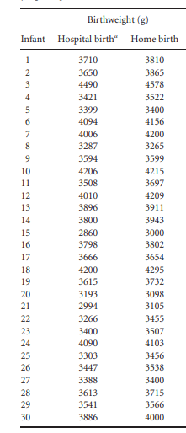
Decoding p-values
Suppose you wanted to determine whether there was a difference in the mean birthweights (g) of infants born in a maternity unit versus at home
Two independent samples of n=30 infants
  Mean weight (hospital): 3644g
  Mean weight (home): 3727g

Slide 14
Decoding p-values
Difference = mean weight (hospital) – mean weight (home)
Estimate for the difference = -82.2g
  On average, babies born at home are 82.2g heavier than babies born in hospital
P-value for the statistical test = 0.407
  P > 0.05 so there is no evidence against the null hypothesis
  40.7% chance that the difference observed (82.2g) could have been due to random variation
Confidence interval for difference = -279.3g to 114.9g
  Confidence interval contains 0 (the null difference) - No difference is a plausible answer
  Babies born in hospital could be between 279.3g lighter to 114.9g heavier than babies born at home
Notes:
Estimate for the difference means that on average the home babies are 82.2g heavier than hospital babies

Slide 15
Section 3: Unravelling Odds Ratios

Slide 16
Unravelling Odds Ratios
In 1988, the Steering Committee of the Physicians’ Health Study Research Group reported that low-dose aspirin (325mg every other day) reduces the risk of myocardial infarction
Statement was based on a 5-year study of a sample of 22,071 participants
  Approximately half the participants were given low-dose aspirin every other day
  The other half were given placebo
DOI: 10.1056/NEJM198907203210301

Slide 17
Unravelling Odds Ratios
Condition | No Myocardial Infarction | Myocardial Infarction
Aspirin | 10,933 | 104
Placebo | 10,845 | 189
Odds relate to a binary outcome where the outcome either occurs or does not occur
  Having a myocardial Infarction while on Aspirin or not having a myocardial infarction while on Aspirin
  How likely an event is to occur relative to it not happening
Odds ratios (ORs) are measures of association with binary outcomes, such as having or not having a myocardial infarction, and whether or not a person experienced something believed to be associated with the outcome (taking aspirin or not)
  How likely an outcome is to occur in one setting relative to another
Notes:
One way to examine these data is to use odds and odds ratios
OR compares the odds of an event in two groups
Odds report the number of events of interest in relation to the number of events not of interest
A common interpretation for odds ratios is identifying risk factors by assessing the relationship between exposure to a risk factor and a medical outcome. For example, is there an association between exposure to a chemical and a disease

Slide 18
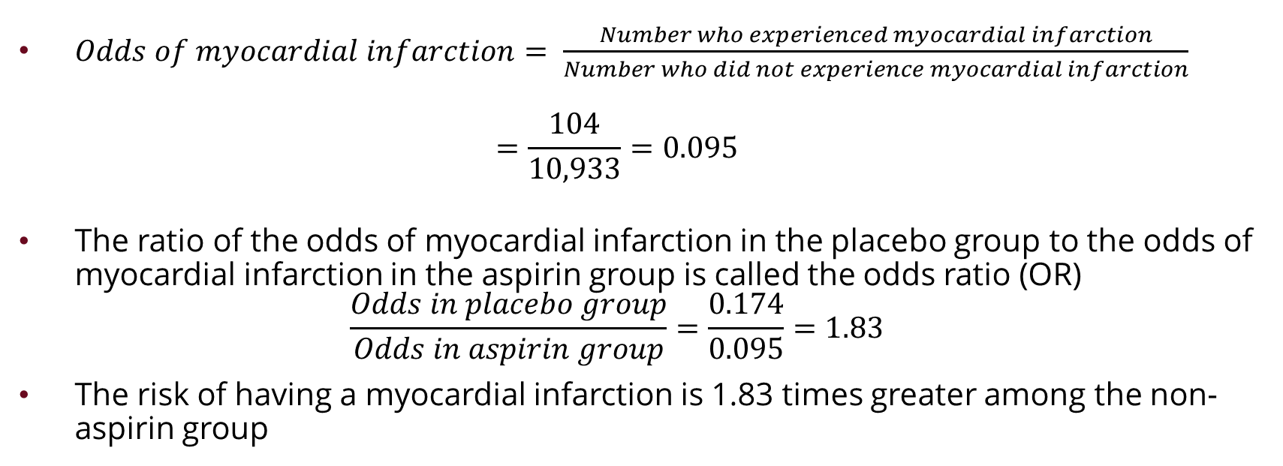
Unravelling Odds Ratios
Condition | No Myocardial Infarction | Myocardial Infarction | Odds of Myocardial Infarction | Odds Ratio
Aspirin | 10,933 | 104 | 0.095 | 1.83
Placebo | 10,845 | 189 | 0.174
$Odds of myocardial infarction= \frac{Number who experienced myocardial infarction}{Number who did not experience myocardial infarction}$
$=\frac{104}{10,933}=0.095$
The ratio of the odds of myocardial infarction in the placebo group to the odds of myocardial infarction in the aspirin group is called the odds ratio (OR)
$\frac{Odds in placebo group}{Odds in aspirin group}=\frac{0.174}{0.095}=1.83$
The risk of having a myocardial infarction is 1.83 times greater among the non-aspirin group
Notes:
O

Slide 19
Unravelling Odds Ratios
The definition of OR shows that if the odds were the same in both groups, the odds ratio would be 1
  In practice, an OR of 1 or close to 1 indicates no evidence of a relationship between exposure and outcome
Sometimes an OR will be accompanied by a p-value which can be interpreted as discussed earlier
  Probability of observing the OR or more extreme under the null hypothesis (i.e., the OR is 1)
  P-value > 0.05 shows there is no evidence against the null hypothesis
    Difference between observed OR and 1 is likely to be natural variation
  P-value < 0.05 shows there is evidence against the null hypothesis
    Difference between OR and 1 is unlikely to be natural variation and could be due to differences in exposure
Notes:
In this example the p-value was <0.001 or 0.1% which is very small
Odds Ratio = 1: The ratio equals one when the numerator and denominator are equal. This equivalence occurs when the odds of the event occurring in one condition equal the odds of it happening in the other condition. There is no association between condition and event occurrence.
Odds Ratio > 1: The numerator is greater than the denominator. Hence, the event’s odds are higher for the group/condition in the numerator. This is often a risk factor.
Odds Ratio < 1: The numerator is less than the denominator. Hence, the probability of the outcome occurring is lower for the group/condition in the numerator. This can be a protective factor.

Slide 20
Section 4: Grasping Hazard Ratios

Slide 21
Grasping Hazard Ratios
Hazard ratios (HRs) are other ways of summarising the chance of something harmful happening in one group of observations divided by the chance of the same event happening in a different group of observations
Frequently seen as an output from survival analysis
  Analyses that focus on the measurement of time from some intervention or procedure to some event of interest
  HR =1 when the hazards are equal
  HR < 1 can indicate protection against unfavourable outcomes
Notes:
For example, if you were studying survival after mastectomy for breast cancer (procedure) then you are thinking about time from mastectomy until death
While OR compare the odds of an event in two groups, HR compares the risk of an even in two groups at any particular point in time
HR how one group changes relative to another

Slide 22
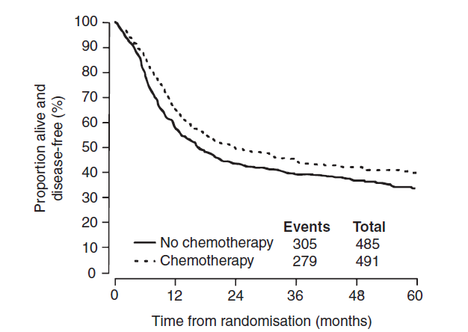
Grasping Hazard Ratios
Survival probabilities are usually visualized using Kaplan-Meier curves
  The curve on the right shows the survival curves for two groups of patients with bladder cancer
  One group was given conventional surgery or radiotherapy (n = 485)
  The other group was given conventional treatment + chemotherapy (n = 491)
  Research question: was the survival experience of the chemotherapy group any better over the 5-year follow-up?
Notes:
Figure taken from a study of chemotherapy for treatment of bladder cancer. Work by the medical Research Council Advanced Bladder Working Group 1999. Published in Lancet

Slide 23
Grasping Hazard Ratios
The survival curves show that the proportions surviving in the chemotherapy arm was larger than those in the no chemotherapy arm
  Number of events (deaths) was 279 in chemotherapy arm vs 305 in the no chemotherapy arm
  Median survival time was 20 months in the chemotherapy arm vs 16.5 months in the no chemotherapy arm
Suppose we are interested in comparing the overall survival experience of these two groups rather than just the median survival times
  Use statistical testing to generate a Hazard Ratio which will allow us to quantify this difference
Notes:
Figure taken from a study of chemotherapy for treatment of bladder cancer. Work by the medical Research Council Advanced Bladder Working Group 1999. Published in Lancet

Slide 24
Grasping Hazard Ratios
The authors reported that the hazard ratio was 0.82 with a 95% CI of 0.70 to 0.97
HR < 1 which shows that the risk of dying in the study period was less for those on chemotherapy compared to those not on chemotherapy
  Risk in the chemotherapy group is 82% of the risk of in the no chemotherapy group
If the HR was 1.2 then the risk in the chemotherapy group is 20% higher over the study period
Notes:
Figure taken from a study of chemotherapy for treatment of bladder cancer. Work by the medical Research Council Advanced Bladder Working Group 1999. Published in Lancet
18% lower risk of early death if you want to discuss it differently

Slide 25
Thank you for attending
Stephen Corson
stephen.corson@phastar.com

