Slide 1

Study Design Considerations For Biotechs
Stephen Corson
stephen.corson@phastar.com
Notes:
This is two different treatment effects (estimands). It is therefore important to define the treatment effect of interest ahead of the study. How = ICHE9RI

Slide 2
Motivation
The FDA regulations on drugs for human use (21CFR314.126) notes that :
“the purpose of conducting clinical investigations of a drug is to distinguish the effect of a drug from other influences, such as spontaneous change in the course of disease, placebo effect, or biased observation”, and
“Reports of adequate and well-controlled investigations provide the primary basis for determining whether there is substantial evidence to support the claims of effectiveness for new drugs”
https://www.accessdata.fda.gov/scripts/cdrh/cfdocs/cfCFR/CFRSearch.cfm?fr=314.126

Slide 3
Motivation
Adequate and well-controlled investigations are noted to have the following characteristics:
  Clear statement of the objectives and a summary of the proposed or actual methods of analysis
  A study design that permits a valid comparison with a control to provide quantitative assessment of drug effect
    Sample size estimation, duration of treatment periods, treatment schedules (e.g., parallel, sequential)
  Method of assigning patients to treatment and control groups that minimizes bias and is intended to ensure comparability of the groups
  Measures taken to minimize bias on the part of the patients, observers, and analysts of the data

Slide 4
Topics Covered In This Webinar
This webinar will cover some key concepts in the design of clinical trials – some of which may be familiar to you
Key concepts mentioned in this webinar are all key to ensuring we have an adequate and well-controlled study
Section 1: Navigating the estimand framework
Section 2: Overview of randomization
Section 3: Understanding the role of blinding
Section 4: Determining sample size

Slide 5
Section 1: Navigating the Estimand Framework

Slide 6
Navigating the Estimand Framework
Study comparing Dapagliflozin to Placebo in patients with diabetes where the sponsor and FDA agreed at AdCom meeting (2011) to use standard endpoint “Change in HbA1c from baseline to 24 weeks”. Glucose-lowering rescue medications were allowed
Sponsor results: For the analysis, HbA1c values after initiation of rescue medication were set to missing (and Sponsor used single imputation LOCF for analysis)
FDA Reviewer: “My own preferred analysis simply uses the observed values of patients who were rescued.”
It would appear a statistical discussion, but it’s actually more profound:
  Sponsor: I am interested in the treatment effect of Dapagliflozin vs Placebo, i.e. comparing treatments in the absence of rescue medication
  FDA reviewer: I am interested in the treatment effect of ‘Dapagliflozin + rescue’ vs ‘Placebo + rescue’, i.e. comparing treatments regardless of rescue medication
Akacha et al, 2016
Notes:
These are two different treatment effects, i.e. two different estimands
It makes sense to define the treatment effect of interest ahead of the study. But how? ICH E9(R1)

Slide 7
Navigating the Estimand Framework
ICH E9(R1), first published in Nov. 2019, provides clarification on E9 and updates the framework to incorporate the language of Estimands in clinical trails
This framework has now been implemented by many of the world’s regulatory authorities (EC, Europe – Jul. 2020; FDA, US - May 2021; NMPA, China – Jan. 2022)
The implementation of the Estimands framework by Global Regulatory Authorities will result in a more widespread use of the language in CSPs and SAPs
The idea is to add clarity in what it is we are estimating and thus use the right study design and analysis methods to answer the questions

Slide 8
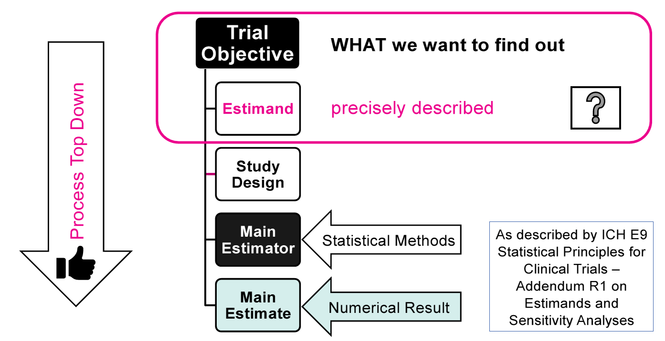
Navigating the Estimand Framework
Estimand Definition: “A precise description of the treatment effect reflecting the clinical question posed by a given clinical trial objective.”
Notes:
Start with clear objectives and estimands are extension of those with additional details thought through – precise description of what we want to find out
Drive study design and conduct as well as determine the statistical methodology
Should lead to more informed decision making

Slide 9
Navigating the Estimand Framework
1
Therapeutic setting and intent of treatment determining a trial objective
2
Identify intercurrent events
3
Discuss strategies to address intercurrent events
4
Construct the estimand(s)
5
Align choices on trial design, data collection and method of estimation
6
Identify assumptions for the main analysis and suitable sensitivity analyses to investigate these assumptions
7
Document the chosen estimands

Slide 10
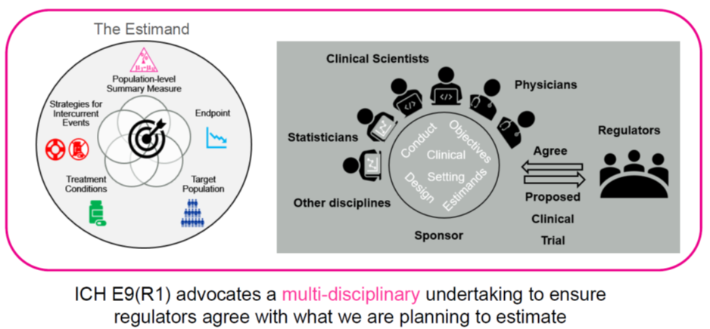
Navigating the Estimand Framework

Slide 11
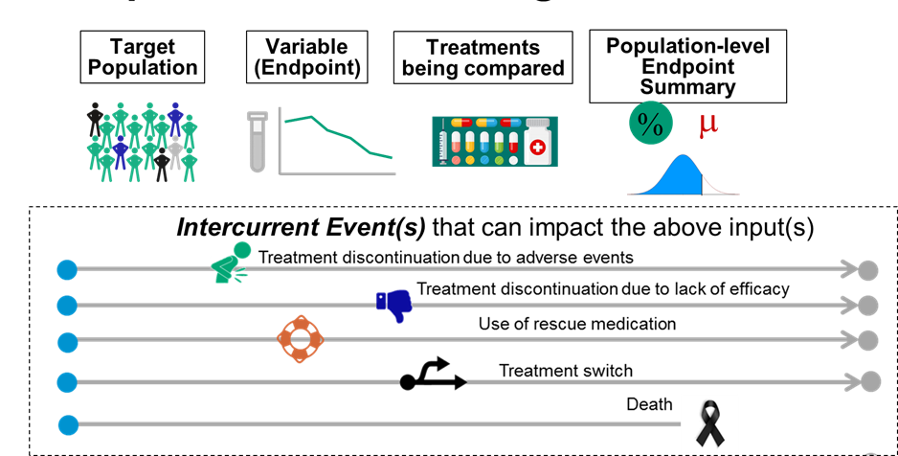
Navigating the Estimand Framework - Components
Intercurrent Events: Events occurring after treatment initiation that impact interpretation or whether or not we are able to collect measurements for the clinical question of interest

Slide 12
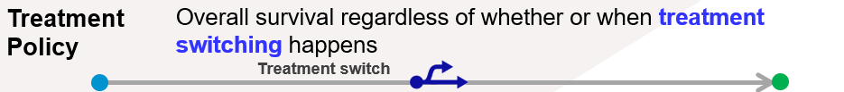
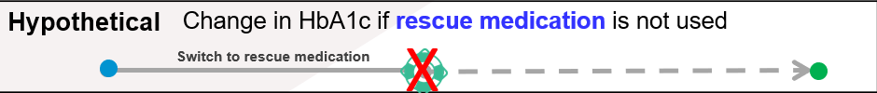
Navigating the Estimand Framework - Strategies
Treatment policy strategy – assume the occurrence of the intercurrent event is irrelevant in defining the treatment effect of interest
Hypothetical strategy – reflects a scenario in which the intercurrent event would not occur
Composite variable strategy – the intercurrent event is considered informative about the patient’s outcome and is incorporated into the variable definition

Slide 13
Navigating the Estimand Framework - Example
What is the difference between means in
change from baseline HbA1c after 26 weeks
in patients with Type 2 diabetes,
treated with oral semaglutide 14mg vs placebo
irrespective of adherence to treatment and with use of rescue medication as required
Population-level summary measure
Endpoint
Population
Treatment conditions
Intercurrent event strategy
Notes:
Intercurrent event strategy forms part of treatment conditions
Rescue medication is reflected according to treatment policy strategy
Treatment discontinuation is also reflected according to treatment policy strategy
What does this mean as per the patient journey
Results at week 26 will be impacted by the intercurrent events but all of the data is relative to the scientific question
Failure to collect the data means you need to think about missing data

Slide 14
Section 2: Overview of Randomization

Slide 15
Overview of Randomization
A process of assigning subjects to treatment arms in a way that minimizes the differences between groups with respect to known or unknown baseline variables (ICH E10)
Randomization provides a sound basis for statistical inference
  Analysis of trial and generalizing to the population

Slide 16

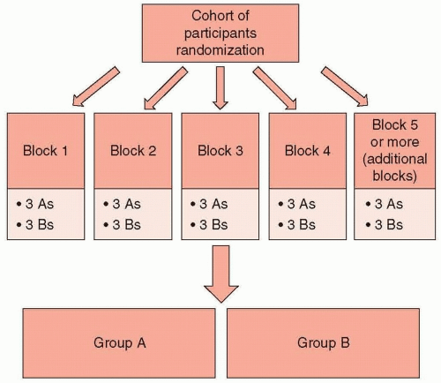
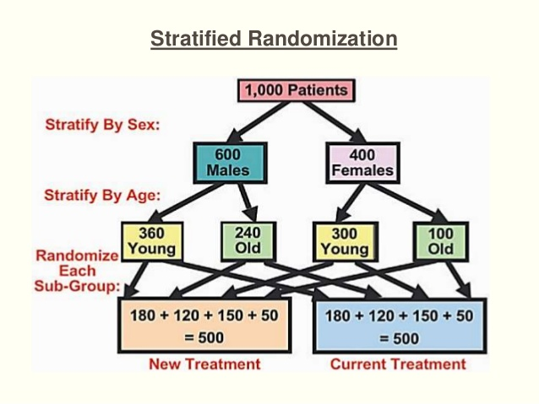
Overview of Randomization
Simple:
Makes each new treatment allocation without considering those already made (e.g., coin toss, sealed envelopes)
Easy to implement– can lead to small inequalities between groups which may be an issue for small studies
Block:
Makes treatment allocations to active or placebo in blocks of size n so every n^{th} subject there are an equal number allocated to each treatment arm
Stratified:
Extends block by balancing both the numbers in each treatment AND a predetermined set of important factors that may impact the study outcomes (e.g., Site, Sex)
Notes:
Large number of stratification variables can lead to imbalances between treatment groups

Slide 17
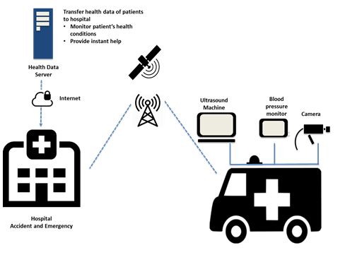

Example from Scientific Study
Title: SatCare: Demonstration Project - Remotely supported ultrasound for rural ambulances
Aim: To extend the capabilities of paramedics, allowing live interaction with remotely-based doctors and equipment, and allowing the team to deliver the correct treatment immediately, both at the place of intervention and during transport
and compare to standard of care
Notes:
In time-critical medical emergencies occurring in remote prehospital environments, minutes can make the difference between life and death; disability and recovery; reducing the time it takes to diagnose and treat a patient can lead to fundamental improvements in emergency medical care.

Slide 18
Section 3: Understanding the Role of Blinding

Slide 19
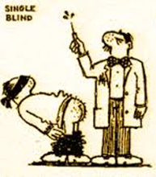
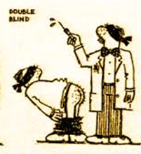
Understanding the Role of Blinding
Blinding refers to keeping study participants (i.e., subject), investigators (e.g., physician) and evaluators unaware of which treatment the subject is receiving
Ensures each subject is treated the same irrespective of what treatment they are receiving
Minimize differences in assessment of subjects, data collection and cleaning, application of analysis methods, interpretation of results and all other aspects of study

Slide 20

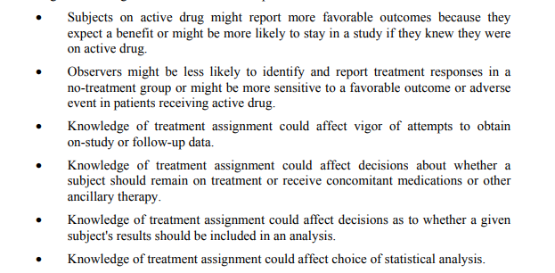
Understanding the Role of Blinding

Slide 21
Understanding the Role of Blinding
A surgeon has developed a new procedure for knee replacement surgery
  To study effectiveness they recruit patients who need knee replacement survey and are willing to participate in a blind study
  Each volunteer is randomly assigned to receive either the new procedure or the standard procedure
What does it mean for the experiment to be blind?
  Volunteers are unaware what is being measured
  Surgeon is unaware of what is being measured
  Surgeon is unaware of which surgery each volunteer receives
  Volunteers are unaware of which surgery they receive

Slide 22
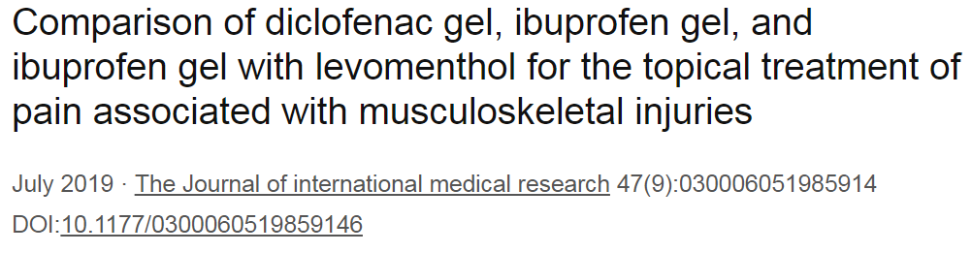
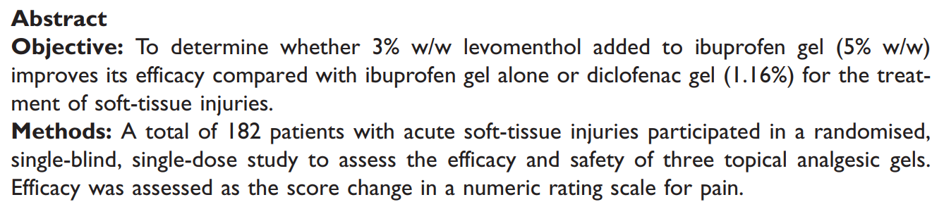
Understanding the Role of Blinding
Blinding a study/maintaining the blinding can be challenging as various factors such as AE profile, lab results, expiration dates can sometimes give people an idea of treatment assignments

Slide 23
Section 4: Determining Sample Size

Slide 24
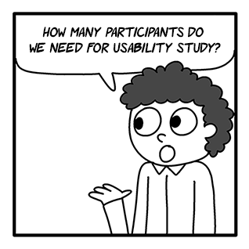
Determining Sample Size
The answer to this seemingly simple question requires a lot of information
  Information is not always reliably known until after the study has been completed
Sample sizes are important parts of ethics approval and protocol
  Study participants are put at risk when taking part
  Undersized study means medical knowledge not advancing
  Resources may be overstretched or diverted from more worthwhile research

Slide 25
Determining Sample Size
Calculations give us the MINIMUM number of participants needed
Estimates are based on several assumptions
  Probability of making a false positive claim (significance level)
    Can be any value but normally 5% or 0.05 what most people are familiar with
  Probability of finding a difference when one exists (power)
    Usually 0.8 (80%) as we accept a 0.2 (20%) probability of a false negative
  What is expected to happen in the control group?
  Variability of results
  How small a difference would it be important to detect (Minimum clinically important difference)?
  Loss to follow-up
Notes:
Smaller significance levels and larger power are ideally preferred but there is an inverse relationship with these two as reducing significance level increases the probability of a false negative and thus reduces power

Slide 26
Example From Scientific Literature
Title: A randomized clinical trial comparing contact lens to intraocular lens correction of monocular aphakia during infancy: grating acuity and adverse events at age 1 year
Aim: to compare the use of immediate IOL implantation to the correction of aphakia with a contact lens after cataract surgery performed in infants with a unilateral congenital cataract between 1 and 6 months of age
Outcomes: The clinical findings up to 12 months after surgery and the visual outcomes at 1 year of age by treatment group
http://www.ncbi.nlm.nih.gov/pmc/articles/PMC3512571/pdf/nihms239534.pdf
Notes:
IOL Intraocular Lens

Slide 27
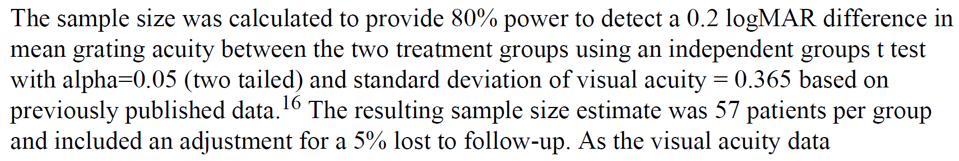
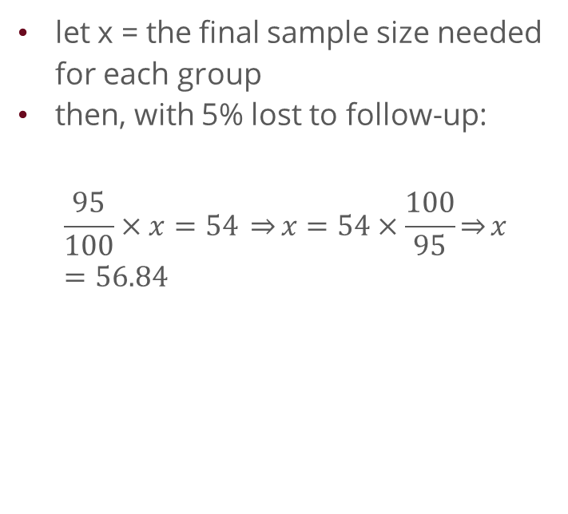
Example From Scientific Literature
Power and Sample Size
2-Sample t Test
Testing mean 1 = mean 2 (versus ≠)
Calculating power for mean 1 = mean 2 + difference
α = 0.05 Assumed standard deviation = 0.365
Sample Target
Difference Size Power Actual Power
0.2 54 0.8 0.805480
The sample size is for each group.
let x = the final sample size needed for each group
then, with 5% lost to follow-up:
$$\frac{95}{100}×x=54 \overset{⇒}{}x=54×\frac{100}{95}\overset{⇒}{}x=56.84$$

Slide 28
Thank you for attending

